Slide 1

Examples of deceptive visualizations
Vargas*, Yang*, Stanley, & Marsh

Slide 2
Here are some graphs.
We would argue that all the graphs here are misleading in some way. This slide deck is meant to be illustrative. It is not exhaustive. Many were found by happenstance e.g., in perusing textbooks and articles, attending talks. By default, we assume they were created without ill will.

Slide 3
Examples of y-axis truncation in bar graphs

Slide 4
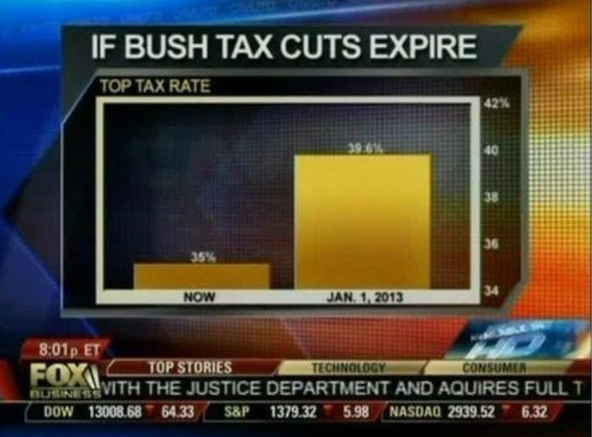
Notes:
https://www.statisticshowto.datasciencecentral.com/misleading-graphs/

Slide 5
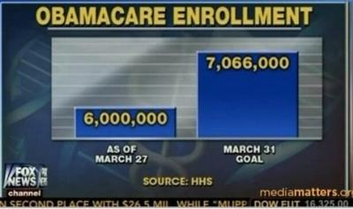
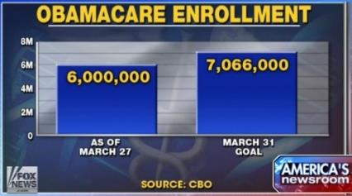
Original Fox News graph
Re-plotted
Notes:
https://www.businessinsider.in/We-Fixed-Fox-News-Embarrassing-Obamacare-Chart/articleshow/33034053.cms
https://thenextweb.com/dd/2015/05/15/7-most-common-data-visualization-mistakes/

Slide 6
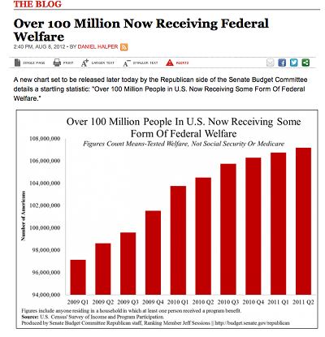
USA Today
Notes:
https://www.statisticshowto.datasciencecentral.com/misleading-graphs/

Slide 7
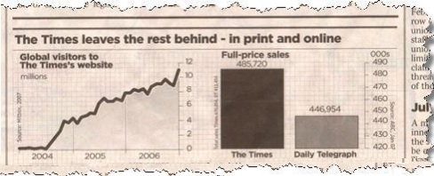
Notes:
“You might be thinking that the graph on the right shows The Times makes double the sales of The Daily Telegraph. But take a closer look at the scale and you’ll see although The Times does make more sales, it’s only beating the competition by about 10%.”
https://www.statisticshowto.datasciencecentral.com/misleading-graphs/

Slide 8
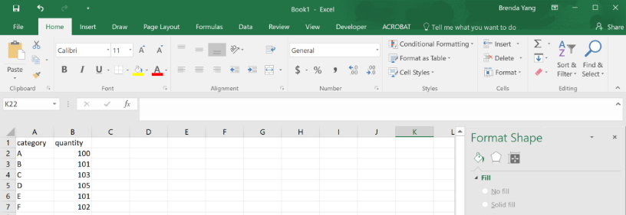
In Excel, the default is to truncate the y-axis in bar graphs.

Slide 9
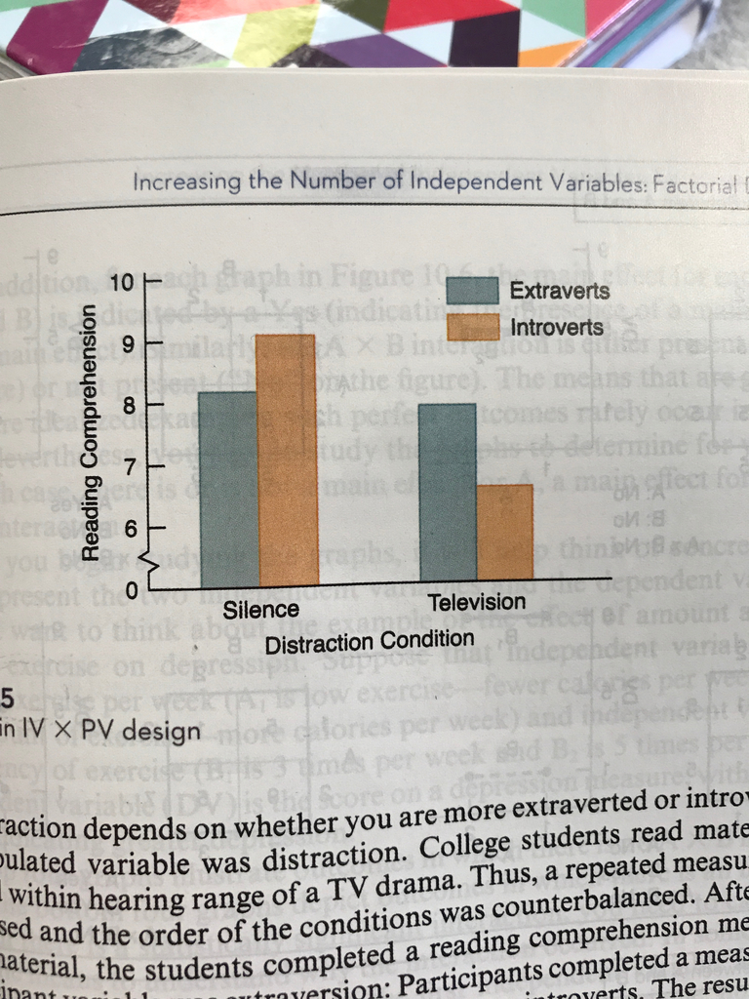
Notes:
Textbook: Cozby, P. C. (2012). Methods in behavioral research (No. 150.72 C6).

Slide 10
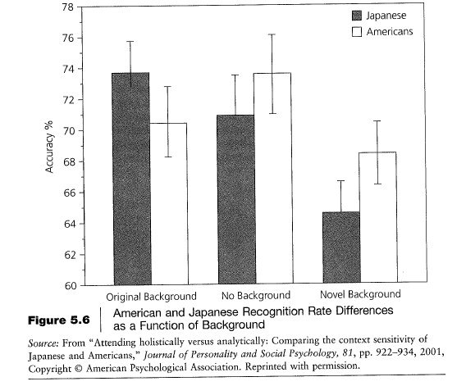
Notes:
Textbook: Culture and Psychology, David Matsumoto & Linda Juang. Wadsworth/Cengage. 6th edition.

Slide 11
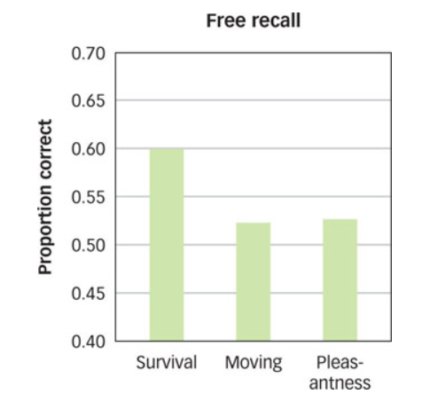
Notes:
Textbook: Schacter, D. L., Gilbert, D. T., & Wegner, D. M. (2009). Introducing psychology. Macmillan.
Figure caption: SURVIVAL ENCODING ENHANCES LATER RECALL People recall more words after survival encoding tasks than after moving or pleasantness-encoding tasks (Nairne et al., 2007). Explain this from an evolutionary perspective.

Slide 12
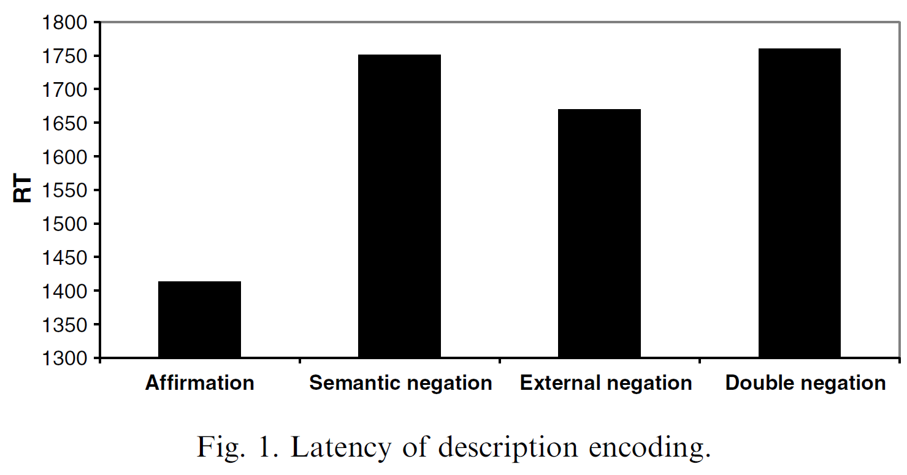
Notes:
Empirical paper: Mayo, R., Schul, Y., & Burnstein, E. (2004). “I am not guilty” vs “I am innocent”: Successful negation may depend on the schema used for its encoding. Journal of Experimental Social Psychology, 40(4), 433–449. https://doi.org/10.1016/j.jesp.2003.07.008

Slide 13
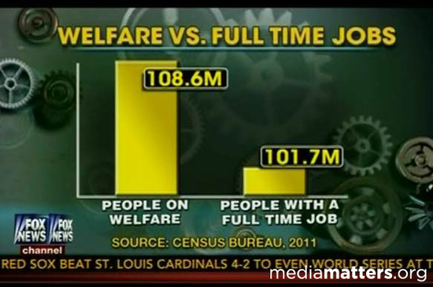
Notes:
Fox News
https://www.statisticshowto.datasciencecentral.com/misleading-graphs/

Slide 14
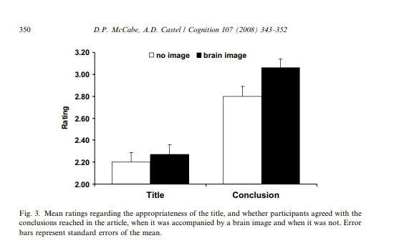

Slide 15
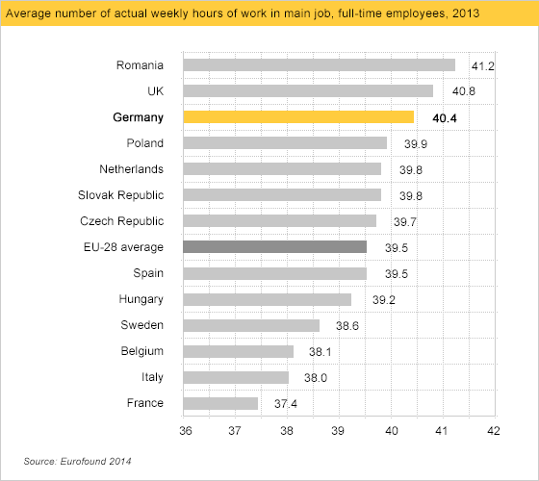
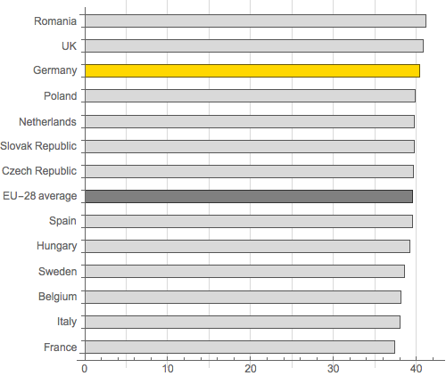
Notes:
https://callingbullshit.org/tools/tools_misleading_axes.html

Slide 16
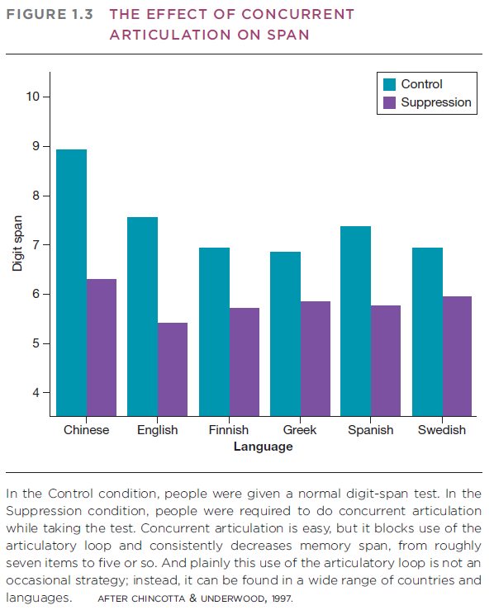
Notes:
Chapter 1 of Reisberg’s Cognition textbook

Slide 17
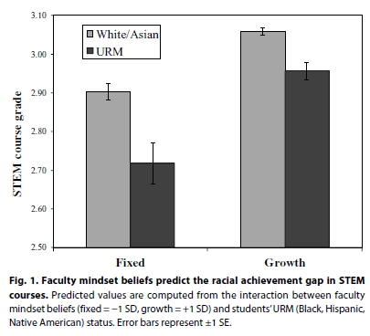
Notes:
Canning et al (2019)

Slide 18
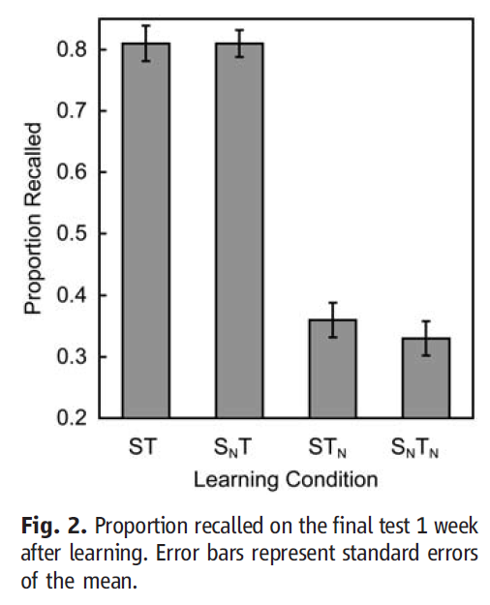
Notes:
Roediger & Karpicke, 2008 (Science)

Slide 19
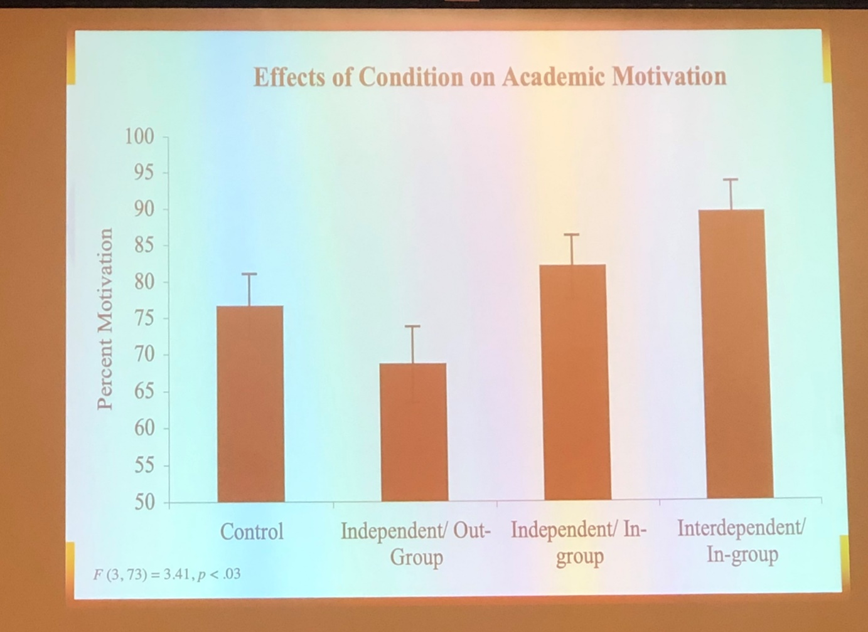
Notes:
Keynote at an academic conference (January 2020)

Slide 20
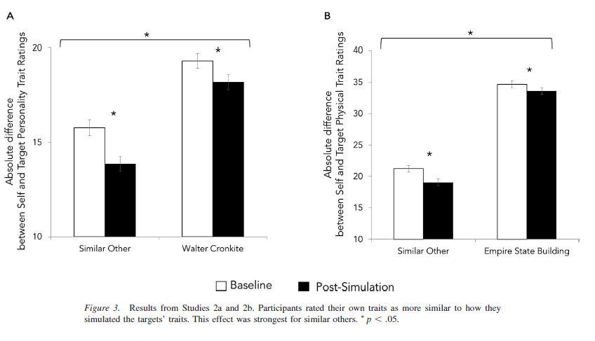
Notes:
Meyer, M. L., Zhao, Z., & Tamir, D. I. (2019). Simulating other people changes the self. Journal of Experimental Psychology: General.

Slide 21
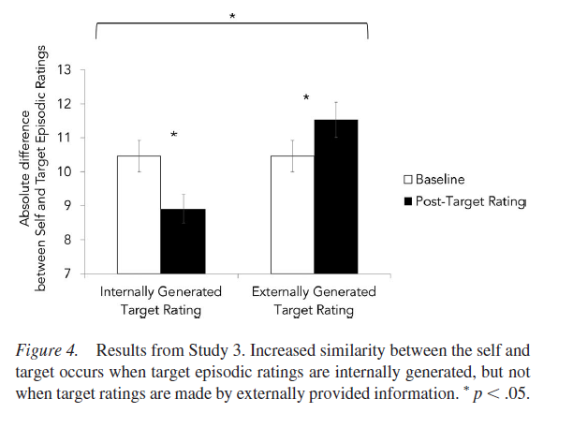
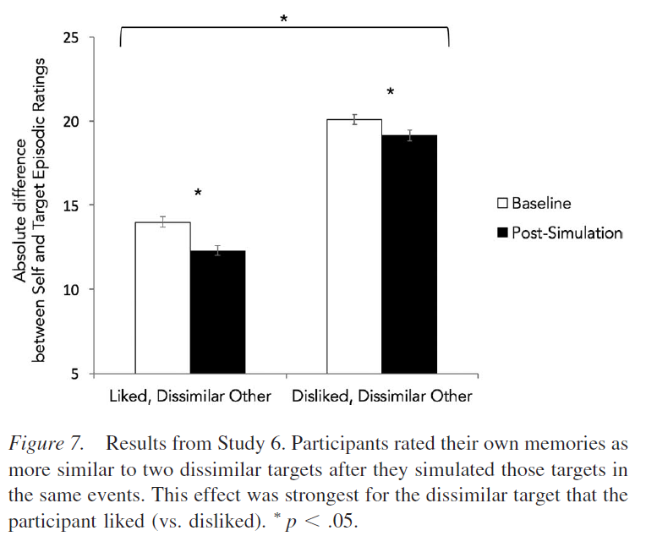
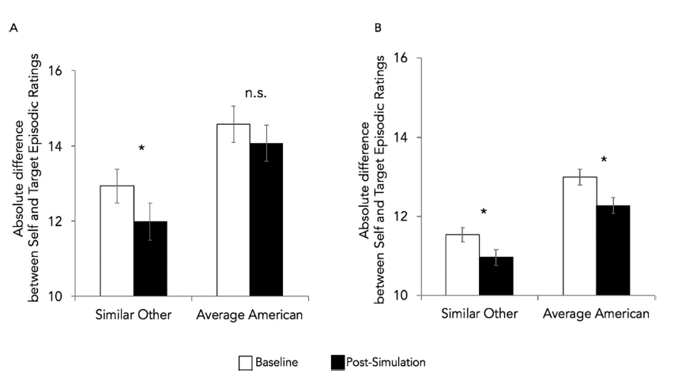
Notes:
Meyer, M. L., Zhao, Z., & Tamir, D. I. (2019). Simulating other people changes the self. Journal of Experimental Psychology: General.

Slide 22
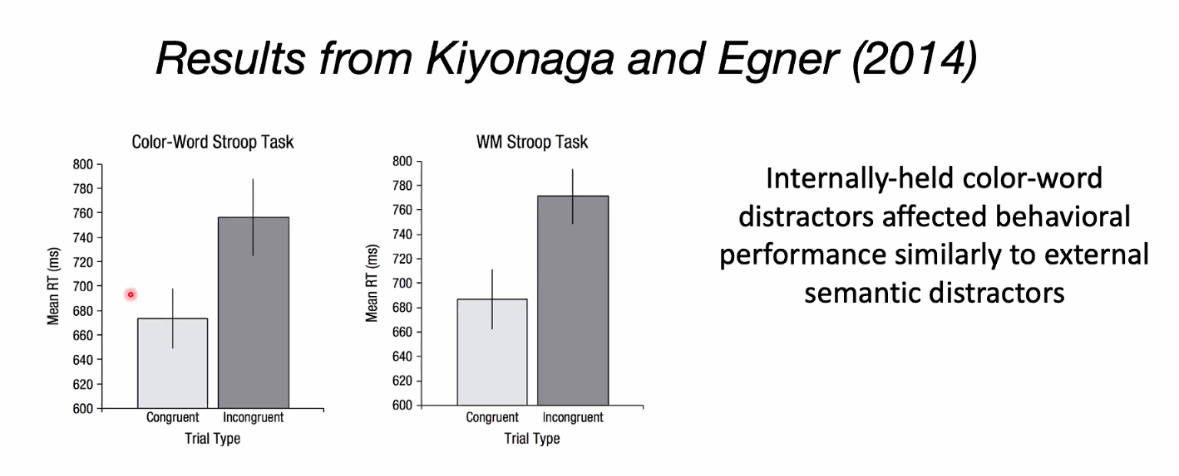

Slide 23
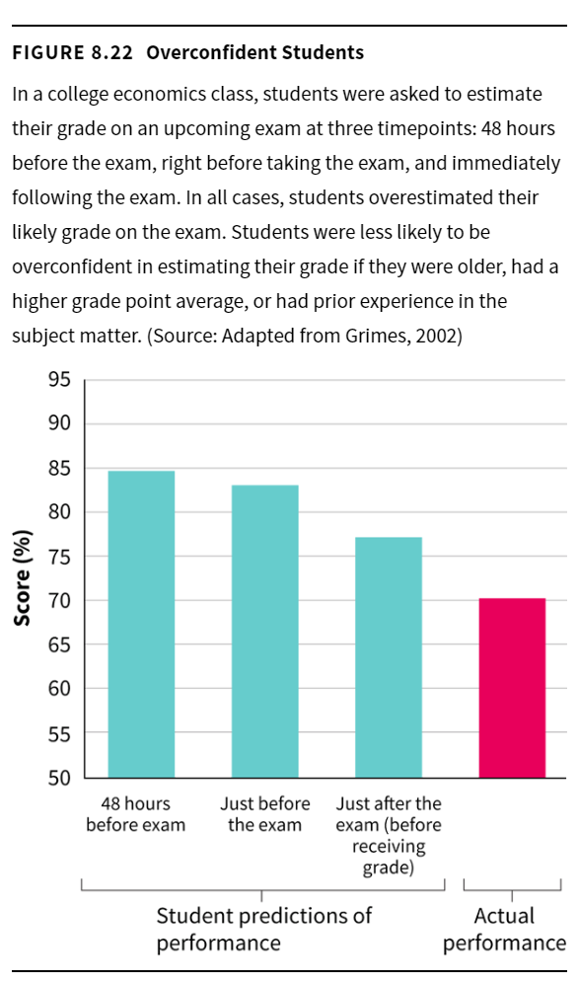
Notes:
Excerpt from an introductory psychology textbook: Interactive Psychology, published by W. W. Norton Co.
Publication date 08/15/2019
ISBN 978-0-393-42143-9

Slide 24
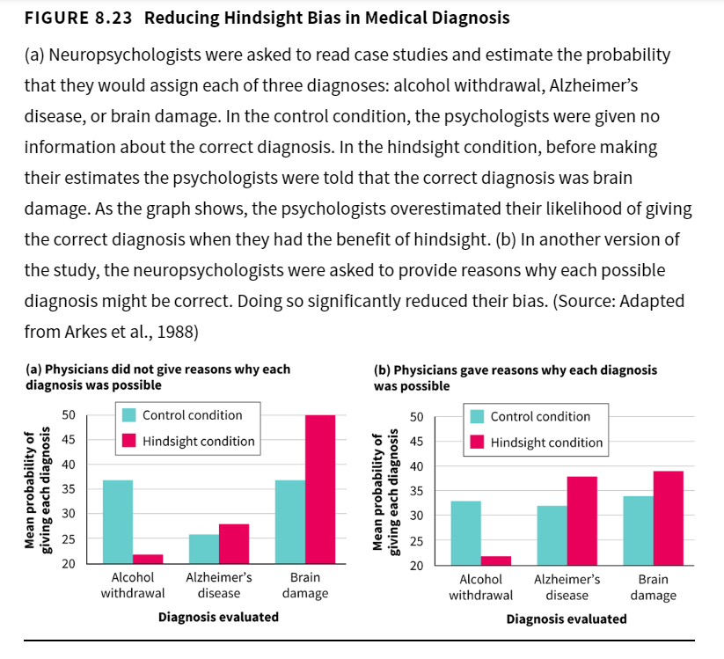
Notes:
Excerpt from an introductory psychology textbook: Interactive Psychology, published by W. W. Norton Co.
Publication date 08/15/2019
ISBN 978-0-393-42143-9

Slide 25
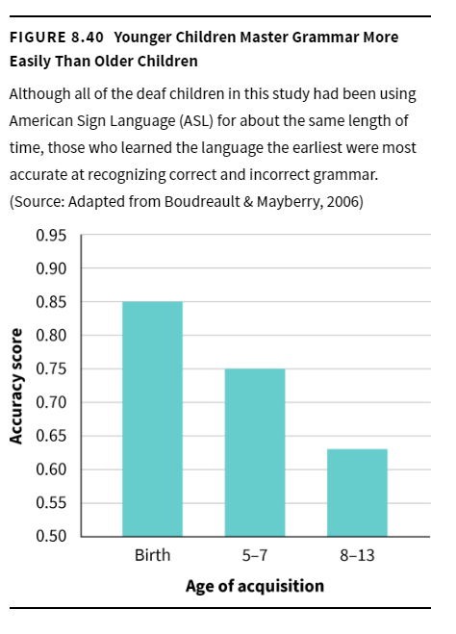
Notes:
Excerpt from an introductory psychology textbook: Interactive Psychology, published by W. W. Norton Co.
Publication date 08/15/2019
ISBN 978-0-393-42143-9

Slide 26
Other techniques and graph types

Slide 27
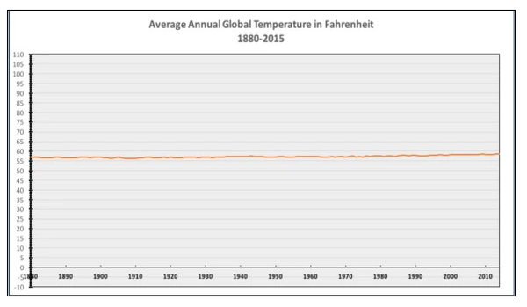
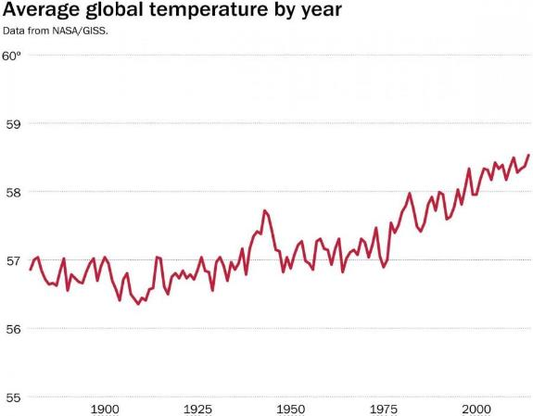
National Review
Two representations of the same set of NASA data on global temperatures.
Source: Washington Post
Notes:
Y-axis manipulation

Slide 28
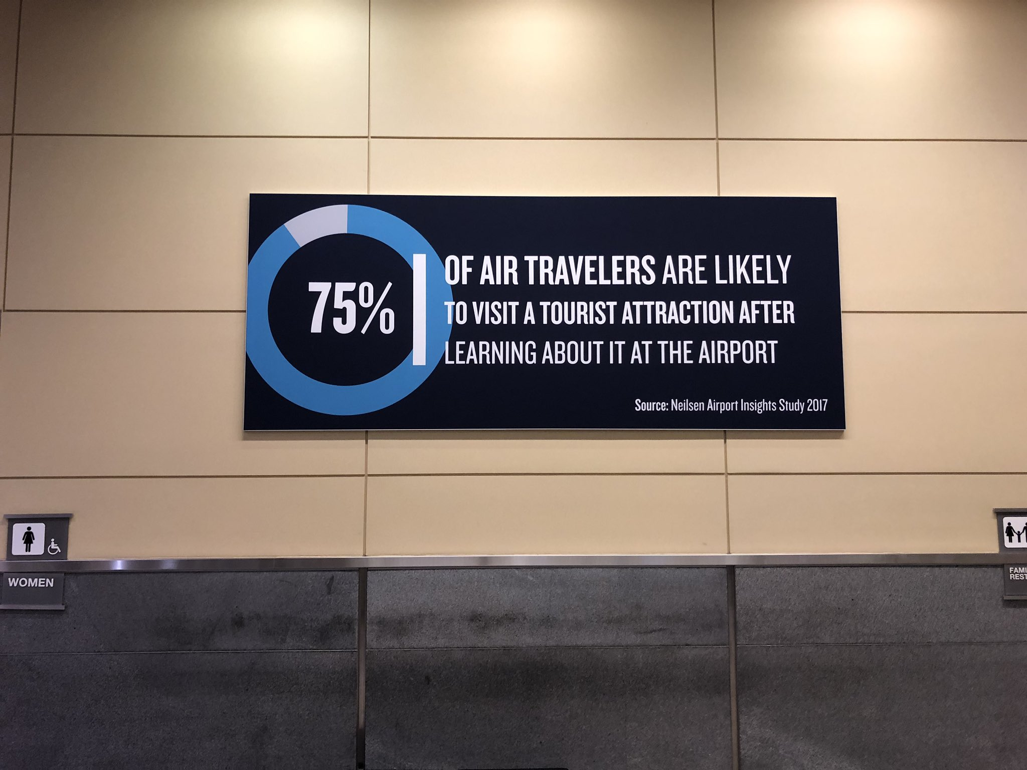
Notes:
Inaccurate proportion
Found at RDU airport by BWY

Slide 29
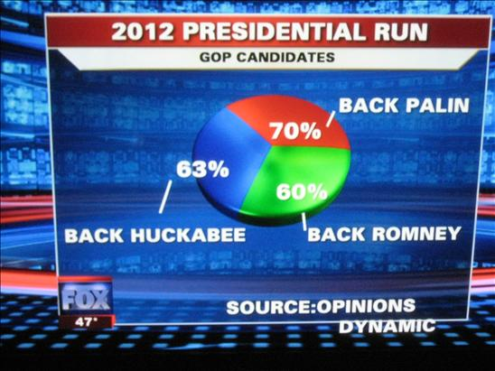
Notes:
Numbers do not add up to 100%
Fox News; found on https://www.statisticshwto.datasciencecentral.com/misleading-graphs/

Slide 30
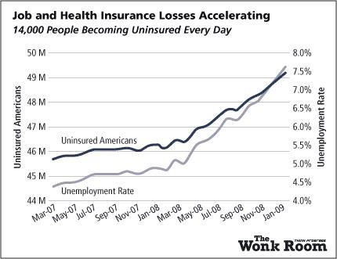
Notes:
Multiple y-axes; y-axis manipulation
https://www.statisticshowto.datasciencecentral.com/misleading-graphs/

Slide 31
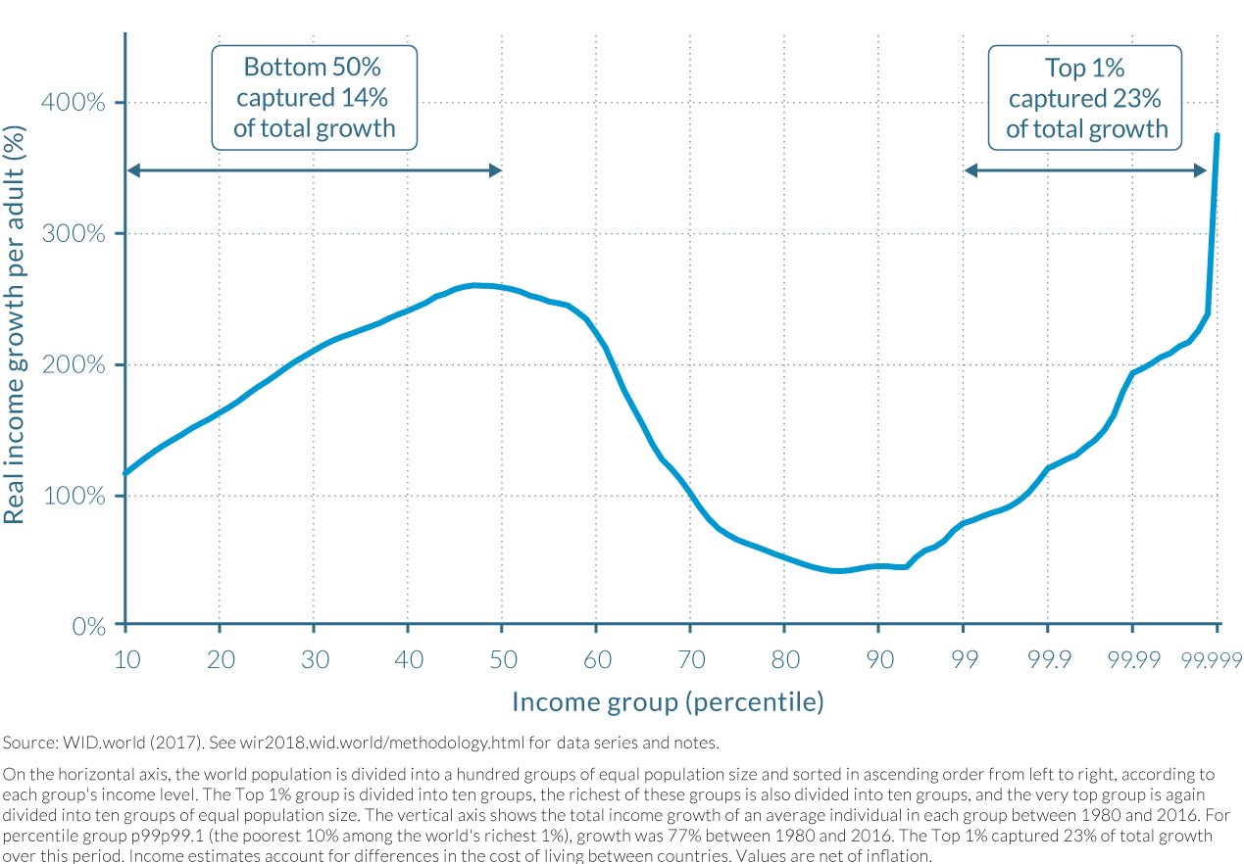
Notes:
X-axis manipulation
https://callingbullshit.org/tools/tools_misleading_axes.html
“The graph reproduced below from World Inequity Report 2018 illustrates the growth in real income from 1980-2016 for the combined populations of China, India, US-Canada, and Western Europe. The purpose of the graph is to indicate where in the wealth distribution most of the growth occurred. The horizontal axis starts out on a linear scale: every 10% of the population is represented by the same distance along the axis. But once the graph reaches 99%, this changes abruptly to a logarithmic scale, in which smaller and smaller segments of the population take up equal size along the horizontal axis. At the far right side of the graph, we have a segment of the population corresponding to less than 0.001% of the population corresponding to a region the same size as used to represent the 10% of the population across the majority of the graph.”

Slide 32
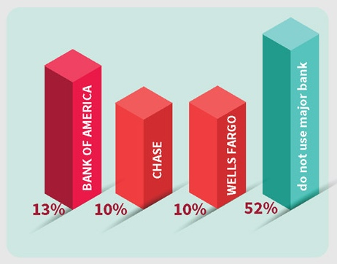
Notes:
Unlabeled axes; unnecessary third dimension
https://undullify.com/data-visualization-102-common-mistakes-visualizing-data/

Slide 33
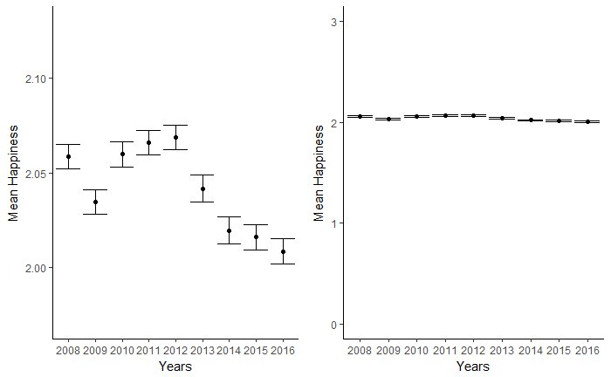
Data published in Twenge, J. M., Martin, G. N., & Campbell, W. K. (2018). Decreases in psychological well-being among American adolescents after 2012 and links to screen time during the rise of smartphone technology. Emotion. Re-plotted by Amy Orben (@OrbenAmy): https://twitter.com/OrbenAmy/status/955485018545156096
Notes:
Y-axis manipulation

Slide 34
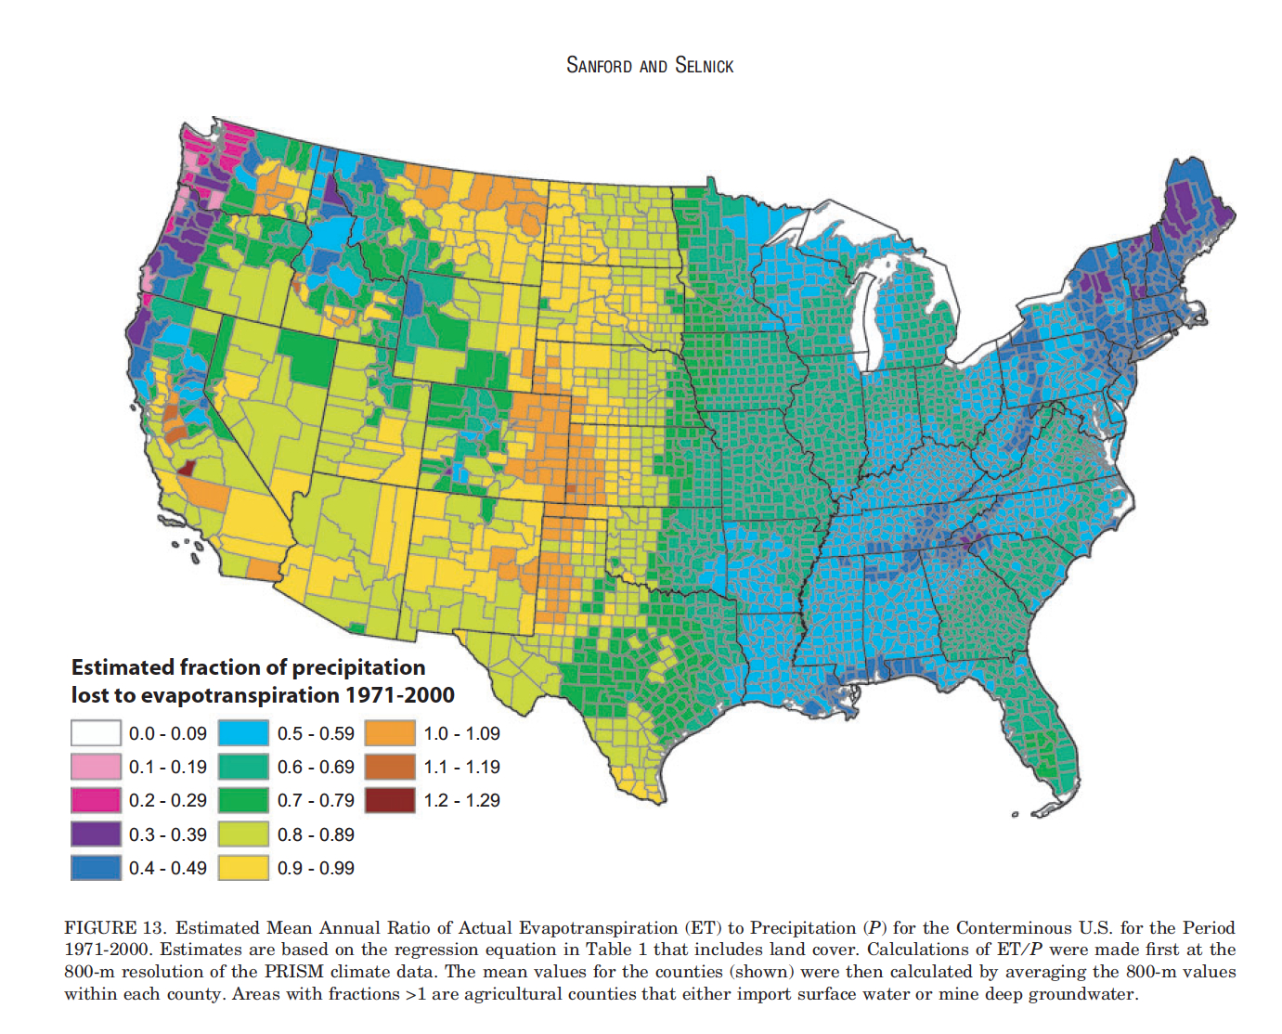
Notes:
Unclear use of color scale
https://eagereyes.org/basics/rainbow-color-map

Slide 35

Notes:
Y-axis reversal
https://www.businessinsider.com/gun-deaths-in-florida-increased-with-stand-your-ground-2014-2
http://www.visualisingdata.com/2014/04/the-fine-line-between-confusion-and-deception/

Slide 36

Notes:
Found in r/dataisugly
Appears to be a bar chart but bars do not represent the numbers. Might be designed as a podium.

